Slide 1
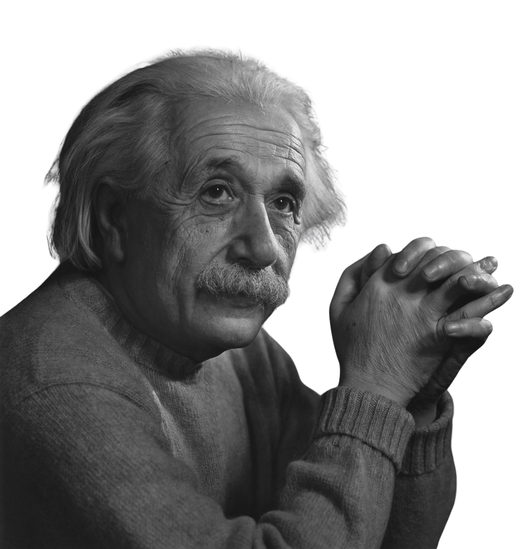
If you can’t explain something simply, you don’t understand it well enough.

Slide 2




Slide 3
“WHAT IS RSS?”

Slide 4

“RSS is an XML-based content syndication format”

Slide 5
💧
💧
💧
💧
💧

Slide 6


“WHERE IN OUR BUSINESS DO WE HAVE AN EXPLANATION PROBLEM?”
Discussion Time…

Slide 7


Slide 8
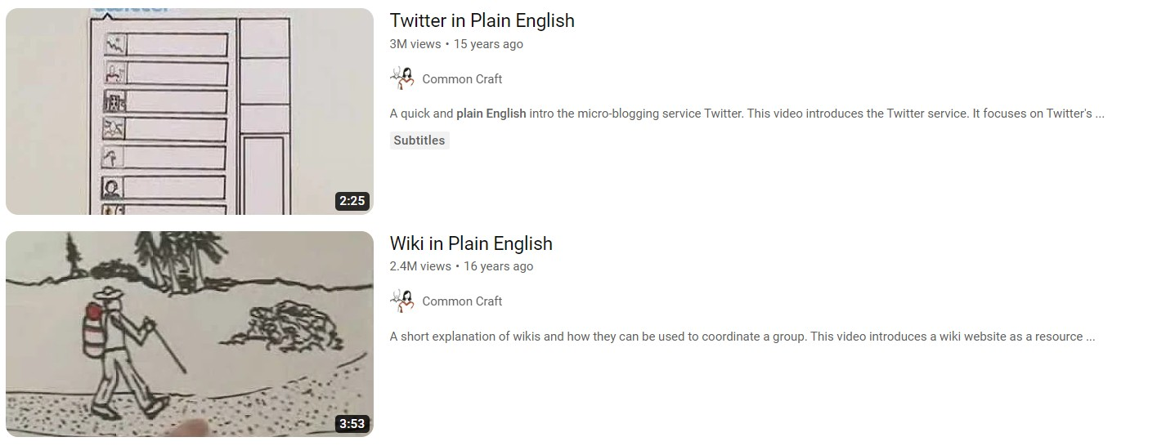
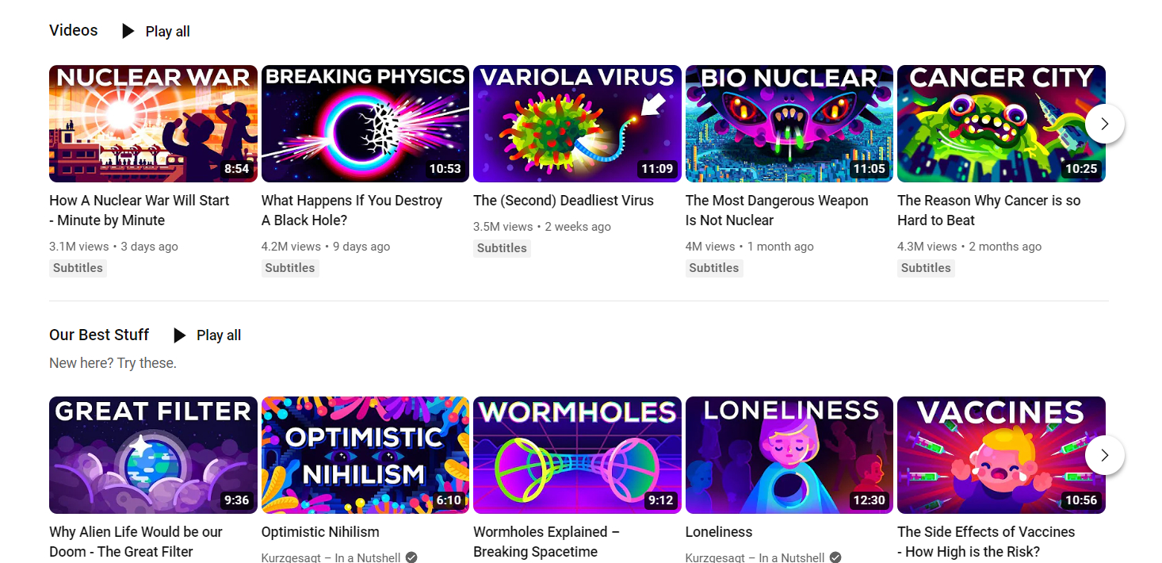
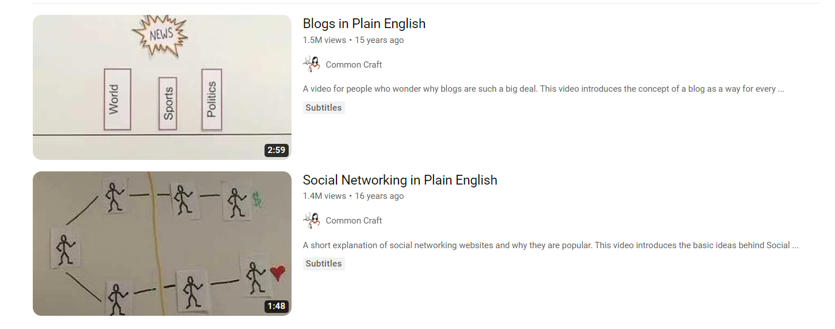
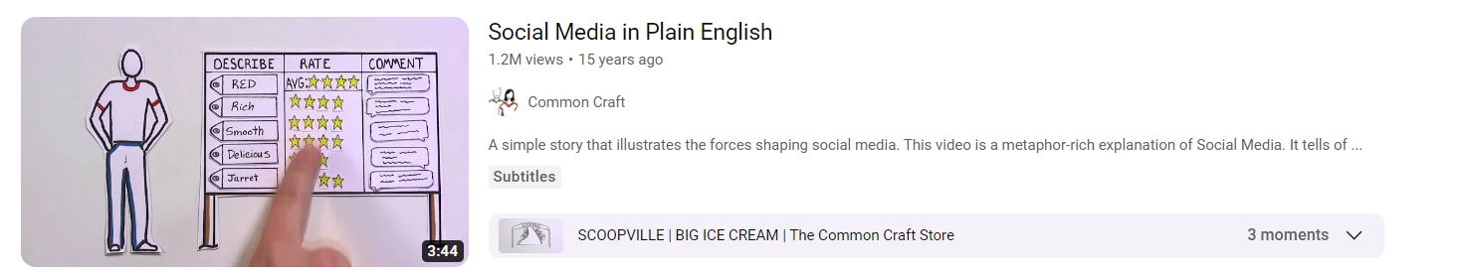

Slide 9
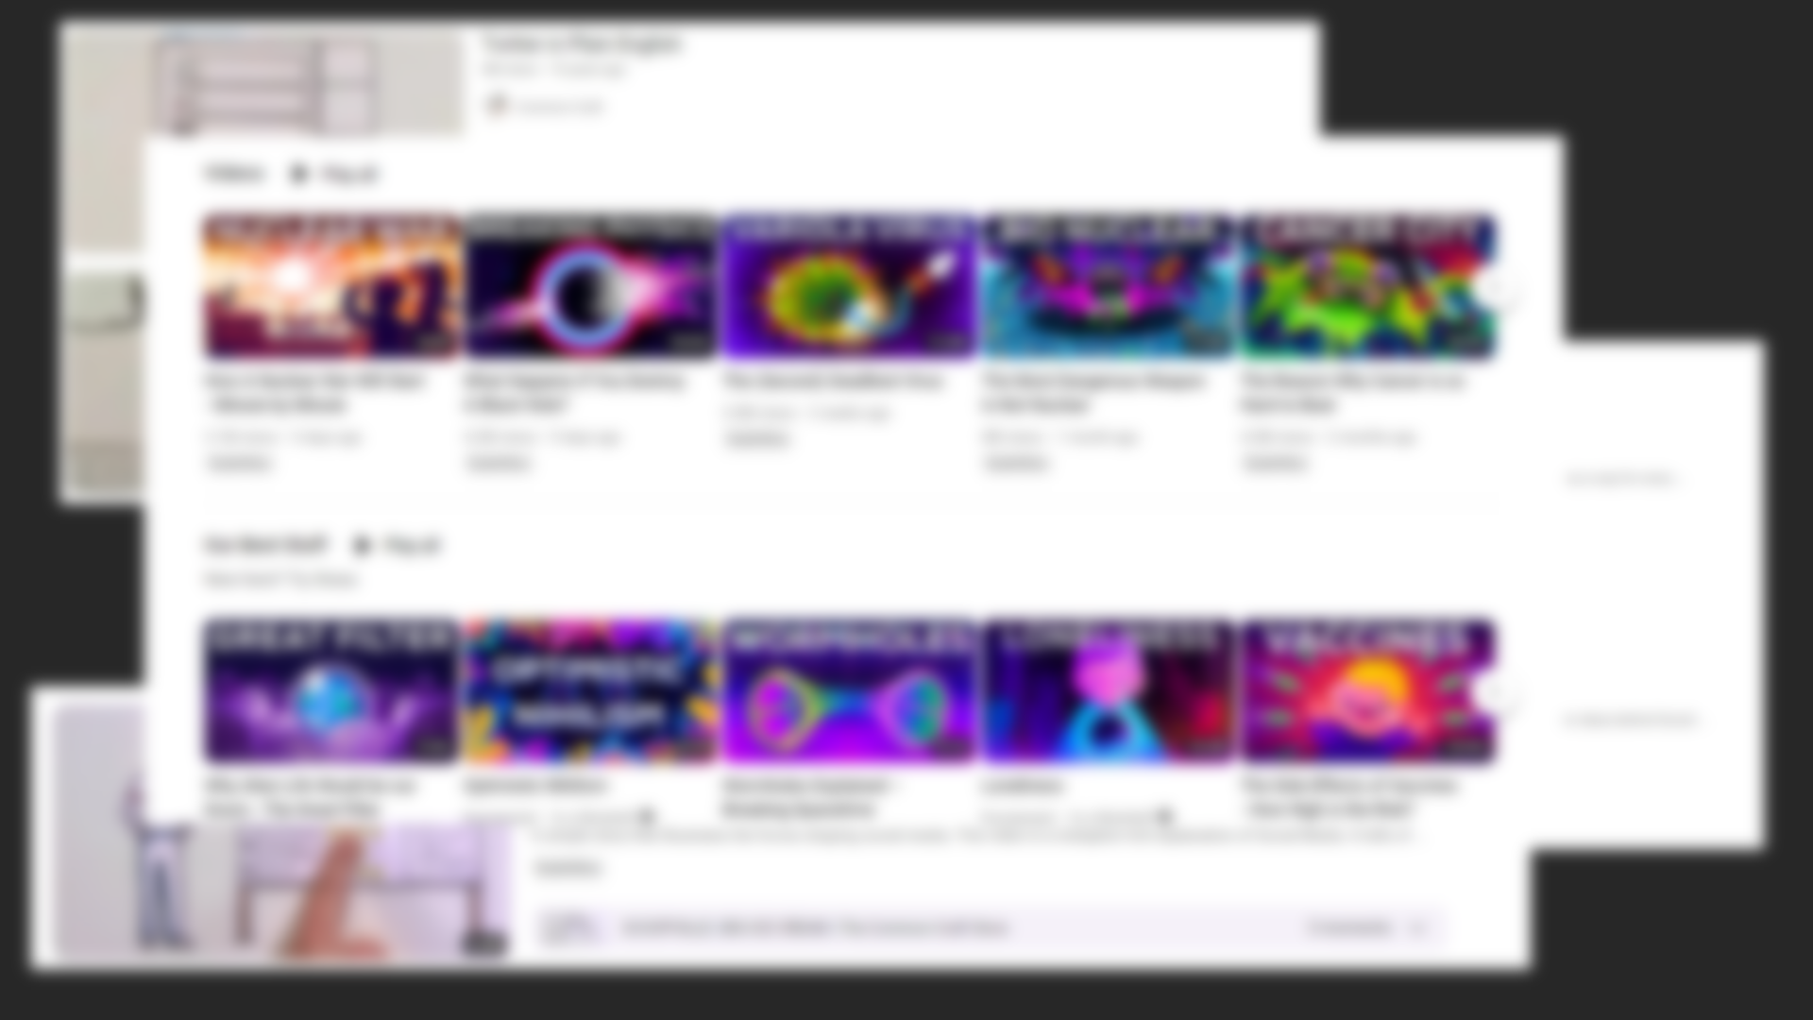
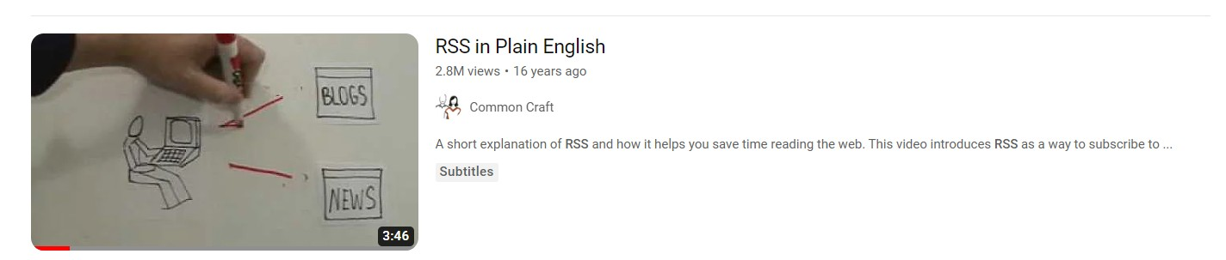

Slide 10




Slide 11
A great idea, poorly explained, ceases to appear great, and the cost is tremendous.
-Lee LeFever

Slide 12



CORE CONCEPT:
The Cost of Understanding: learning has a cost, if the cost seems too high,
their willingness to learn decreases.
3 Principles:
SIMPLIFY
CONNECT
STORY

Slide 13

CORE CONCEPT:
The Cost of Understanding: learning has a cost, if the cost seems too high,
their willingness to learn decreases.
3 Principles:
SIMPLIFY
CONNECT
STORY

Slide 14
1:SIMPLIFY

Slide 15
Jargon… Jargon… Jargon…
You get it?

Slide 16

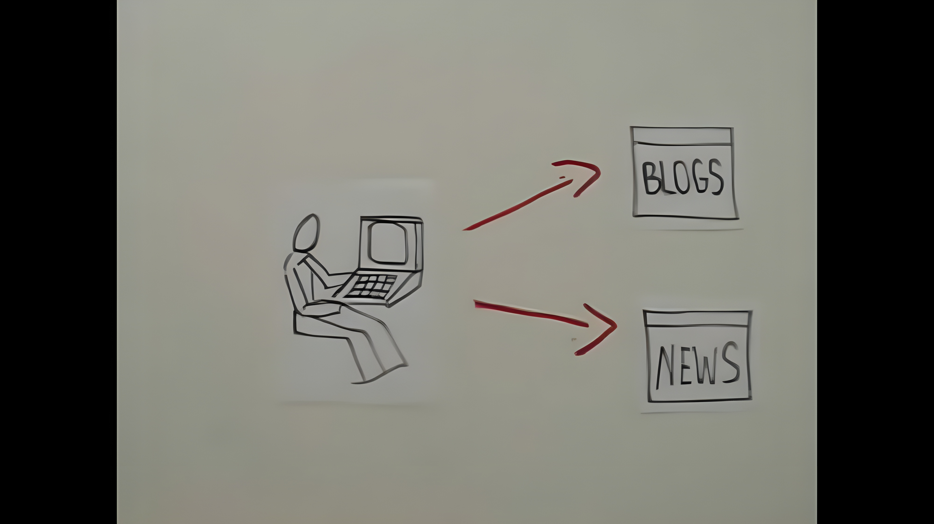

Slide 17

“Explanations fail when we are unable to translate the language of our work to the language of a possibly uninformed audience.”
-Lee LeFever

Slide 18
“Keep it simple.”

Slide 19

2:CONNECT

Slide 20



50%

Slide 21
3%

Slide 22
The Curse of Knowledge

Slide 23




THE
PITCH

Slide 24




3:STORY

Slide 25



“The difference between fact-telling and storytelling is the difference between watching a stock ticker and hearing a story about an elderly woman who lost every dime she needs for shelter because the market just tanked.”
-Al Tompkins

Slide 26
Notes:
Not devoid of facts

Slide 27
Facts give stories substance,

Slide 28
Facts give stories substance,
but stories give facts meaning

Slide 29
WE NEED BOTH

Slide 30
CORE CONCEPT:
The Cost of Understanding: learning has a cost, if the cost seems too high,
their willingness to learn decreases.
3 Principles:
SIMPLIFY
CONNECT
STORY
Notes:
Simplifying makes it comprehensible, Connecting makes it understandable and using Story makes it memorable

Slide 31
Discussion Time…
WHERE, WITH THESE PRINCIPLES IN MIND, CAN WE AS A TEAM IMPROVE OUR EXPLANATIONS?

Slide 32
FOR THIS WEEK, LET’S AIM TO EXPLAIN THE COMPLICATED ASPECTS OF OUR BUSINESS, IN THEIR SIMPLEST AND MOST MEMORABLE FORM.
Forward Focus…

Slide 33
“EXPLANATION IS NOT FOCUSED ON FACTS, LAWS, OR SPECIFICS.
EXPLANATION IS THE ART OF SHOWING WHY THE FACTS, LAWS, AND SPECIFICS MAKE SENSE.”

Slide 34
Facts give stories substance,

Slide 35
Facts give stories substance,
but stories give facts AVATAR

