Slide 1
“The key to successful leadership today is influence, not authority”
-Ken Blanchard

Slide 2
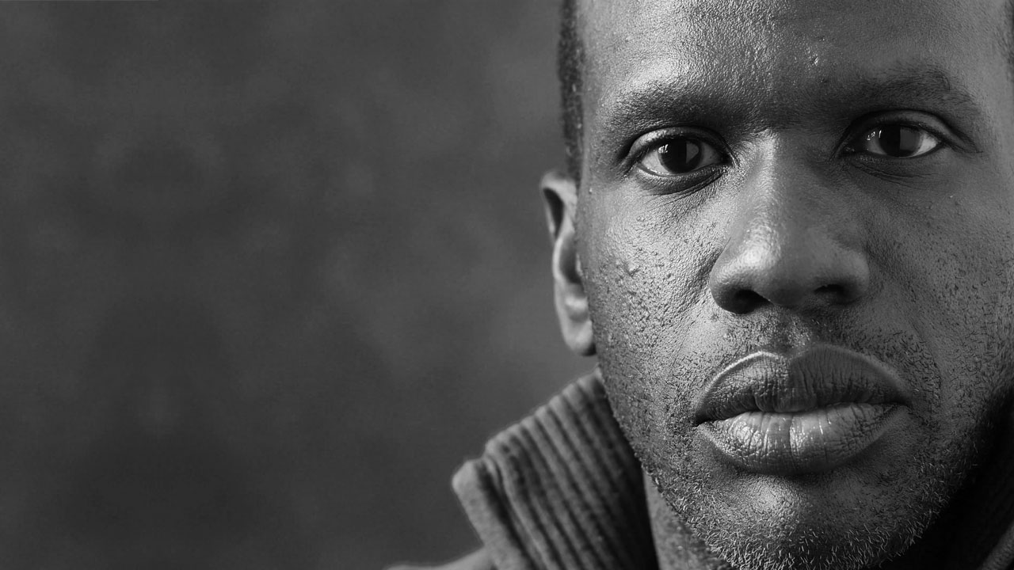

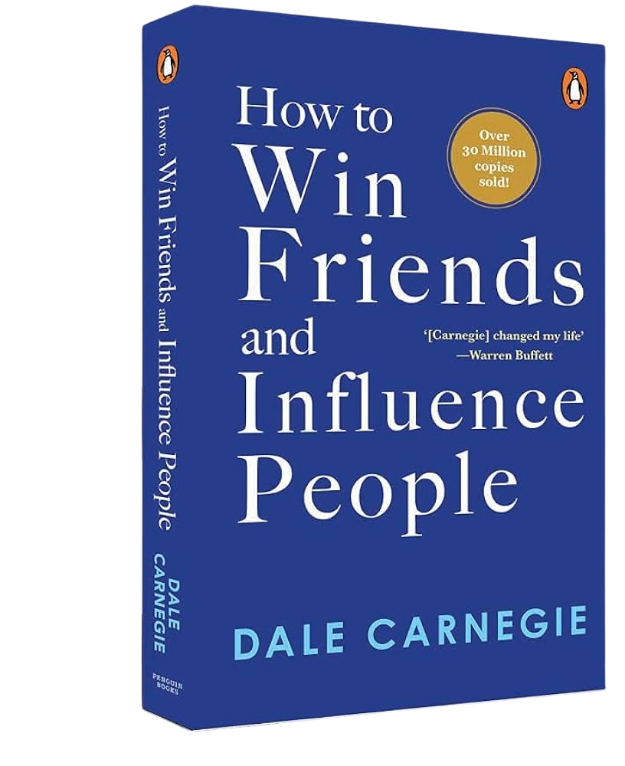
CORE CONCEPT:
The People Bible:
This should be your holy book on all things relating to interactions.

Slide 3

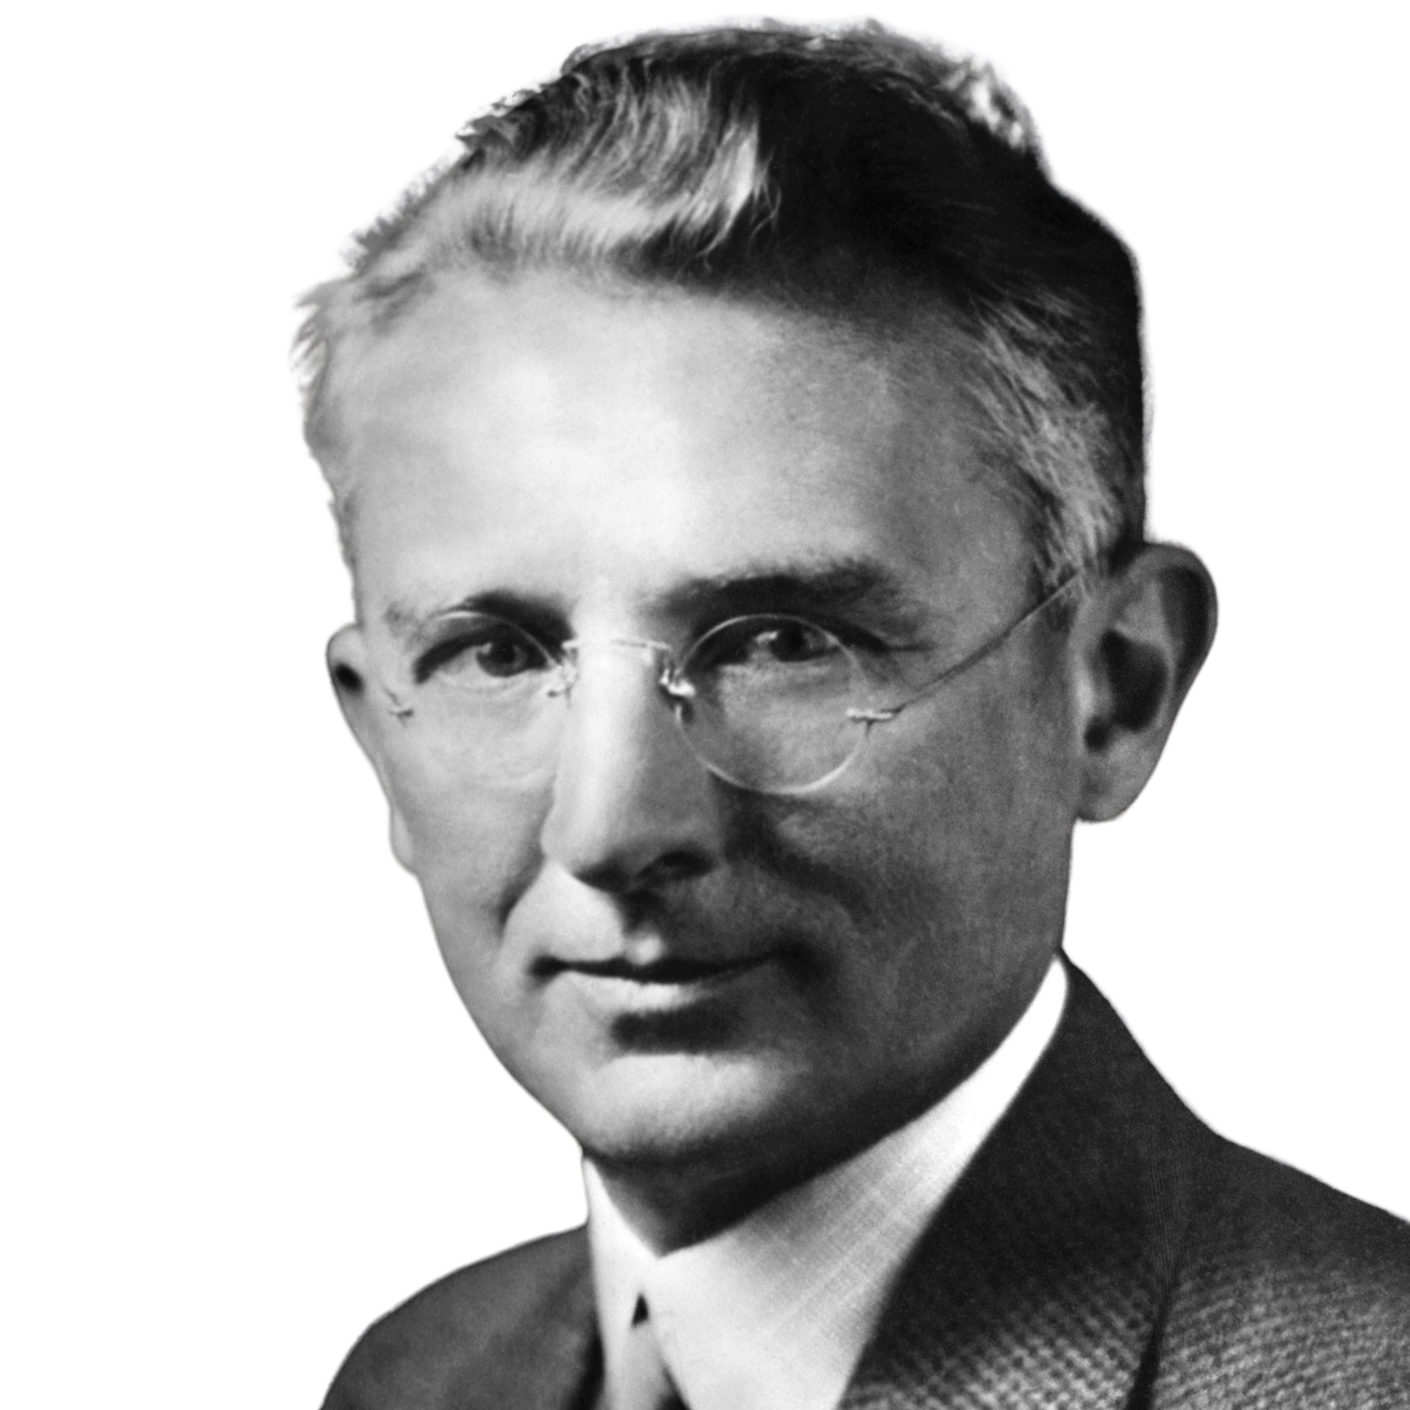


Slide 4


“Let’s talk about a time where somebody may not have seen things from our perspective, did that lead to any problems?”
Discussion Time…

Slide 5
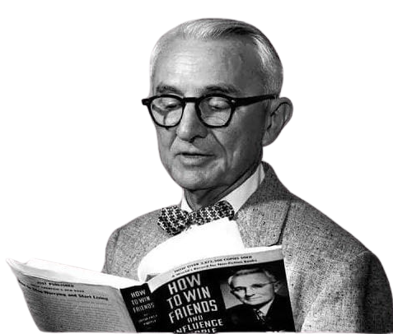
Any fool can criticize, complain, and condemn, and most fools do. But it takes character and self-control to be understanding and forgiving.
-Dale Carnegie

Slide 6

Tricks of the Trade:
Avoid Arguments
Yes-Set Technique
Idea Ownership

Slide 7


AVOID THE ARGUMENT
Notes:
Not a guide to win arguments

Slide 8
ARGUMENTS MAKE NO SENSE!

Slide 9





Slide 10
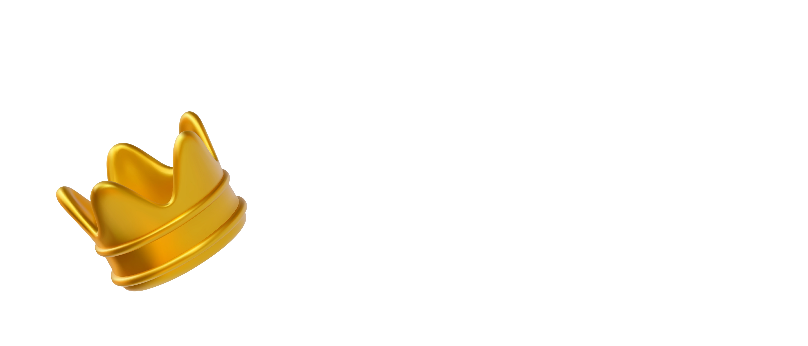
Alex Loses:
Lost credibility
Others might have a bias against him for future projects.
Has exerted no influence whatsoever

Slide 11

Taylor Loses:
Unheard
Resentful
Less inclined to work with the current strategy

Slide 12
You can't win an argument. You can't because if you lose it, you lose it; and if you win it, you lose it.
-Dale Carnegie

Slide 13
NEVER LET
IT
BECOME AN ARGUMENT!

Slide 14

THE YES-SET TECHNIQUE

Slide 15



Slide 16


YES!
YES!
YES!

Slide 17
YES!
YES!
YES!
YES!

Slide 18
MAKE AGREEING THE DEFAULT RESPONSE

Slide 19


INFLUENCE: AGREEABLITY

Slide 20
The only way on earth to influence other people is to talk about what they want and show them how to get it.
-Dale Carnegie

Slide 21

IDEA OWNERSHIP

Slide 22
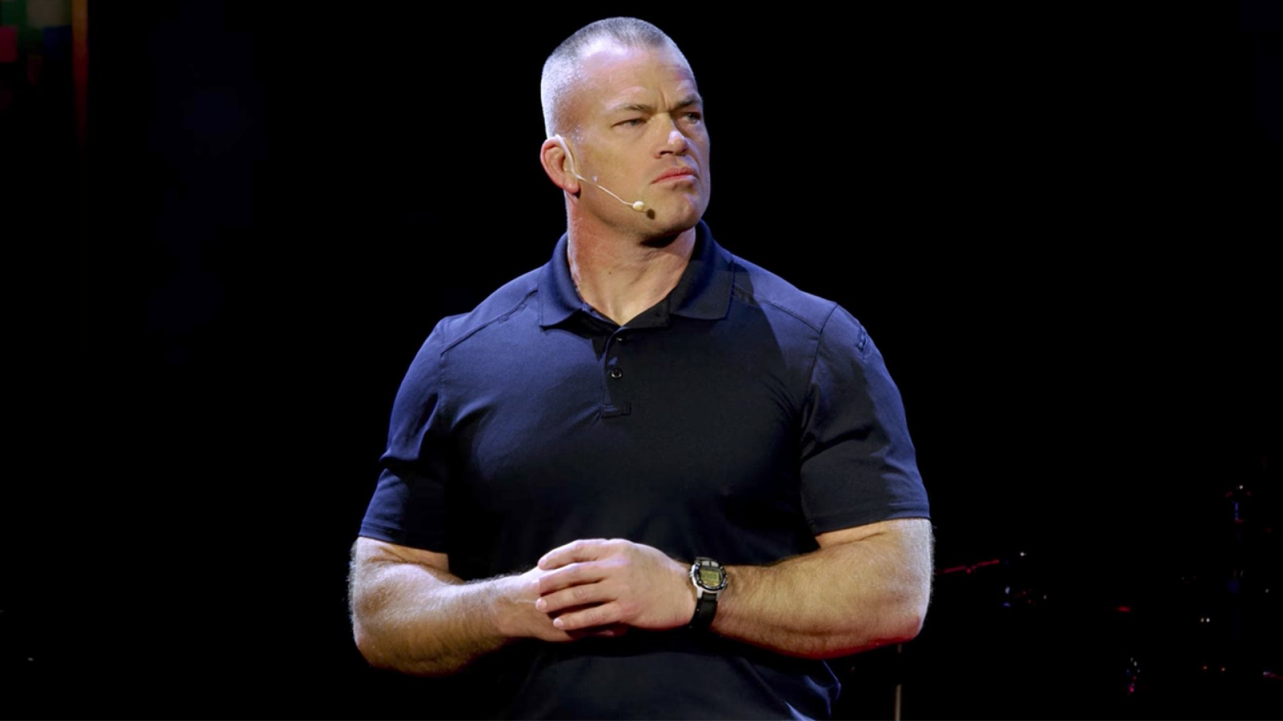

Slide 23

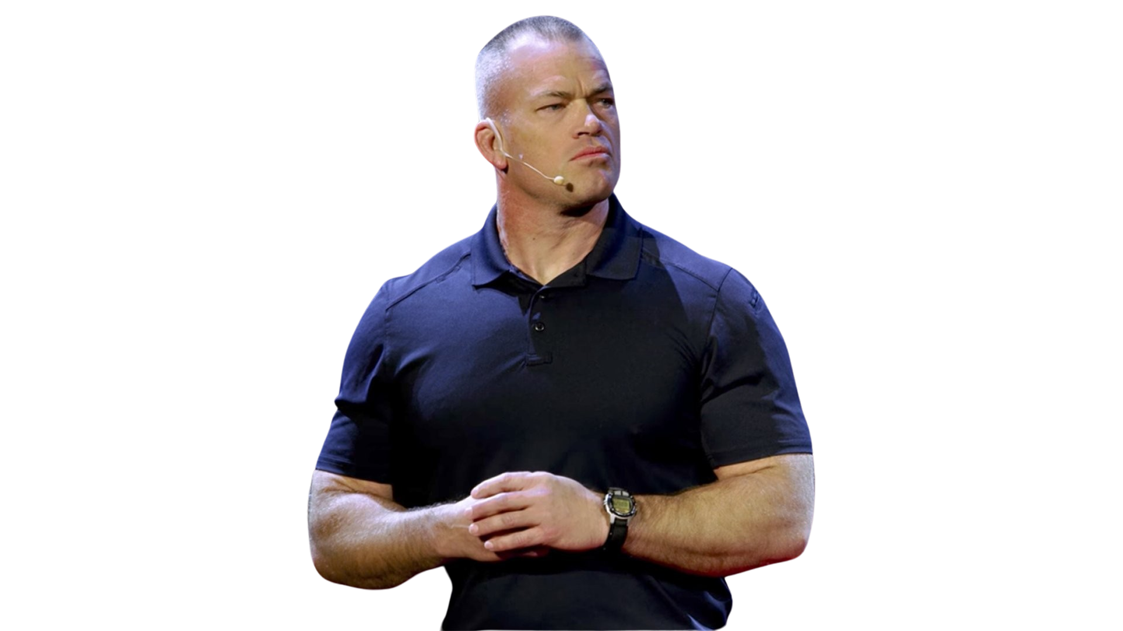

Slide 24



Slide 25

INFLUENCE: COMMITMENT
YOUR IDEAS
THEIR IDEAS

Slide 26


“You cannot teach a man anything;

Slide 27
“You cannot teach a man anything;
you can only help him to find it within himself.”

Slide 28
Tricks of the Trade:
Avoid Arguments
Yes-Set Technique
Idea Ownership

Slide 29
Discussion Time…
How, with these new techniques having been acquired, who are the people around you that you want to influence?

Slide 30
For this week, don’t just take action for yourself, take actions which result in others taking action, and by doing so, you have influenced those around you.
Forward Focus…

Slide 31
"People who can put themselves in the place of other people, who can understand the workings of their minds…

Slide 32
need never worry about what the future has in store for them.."

