Slide 1

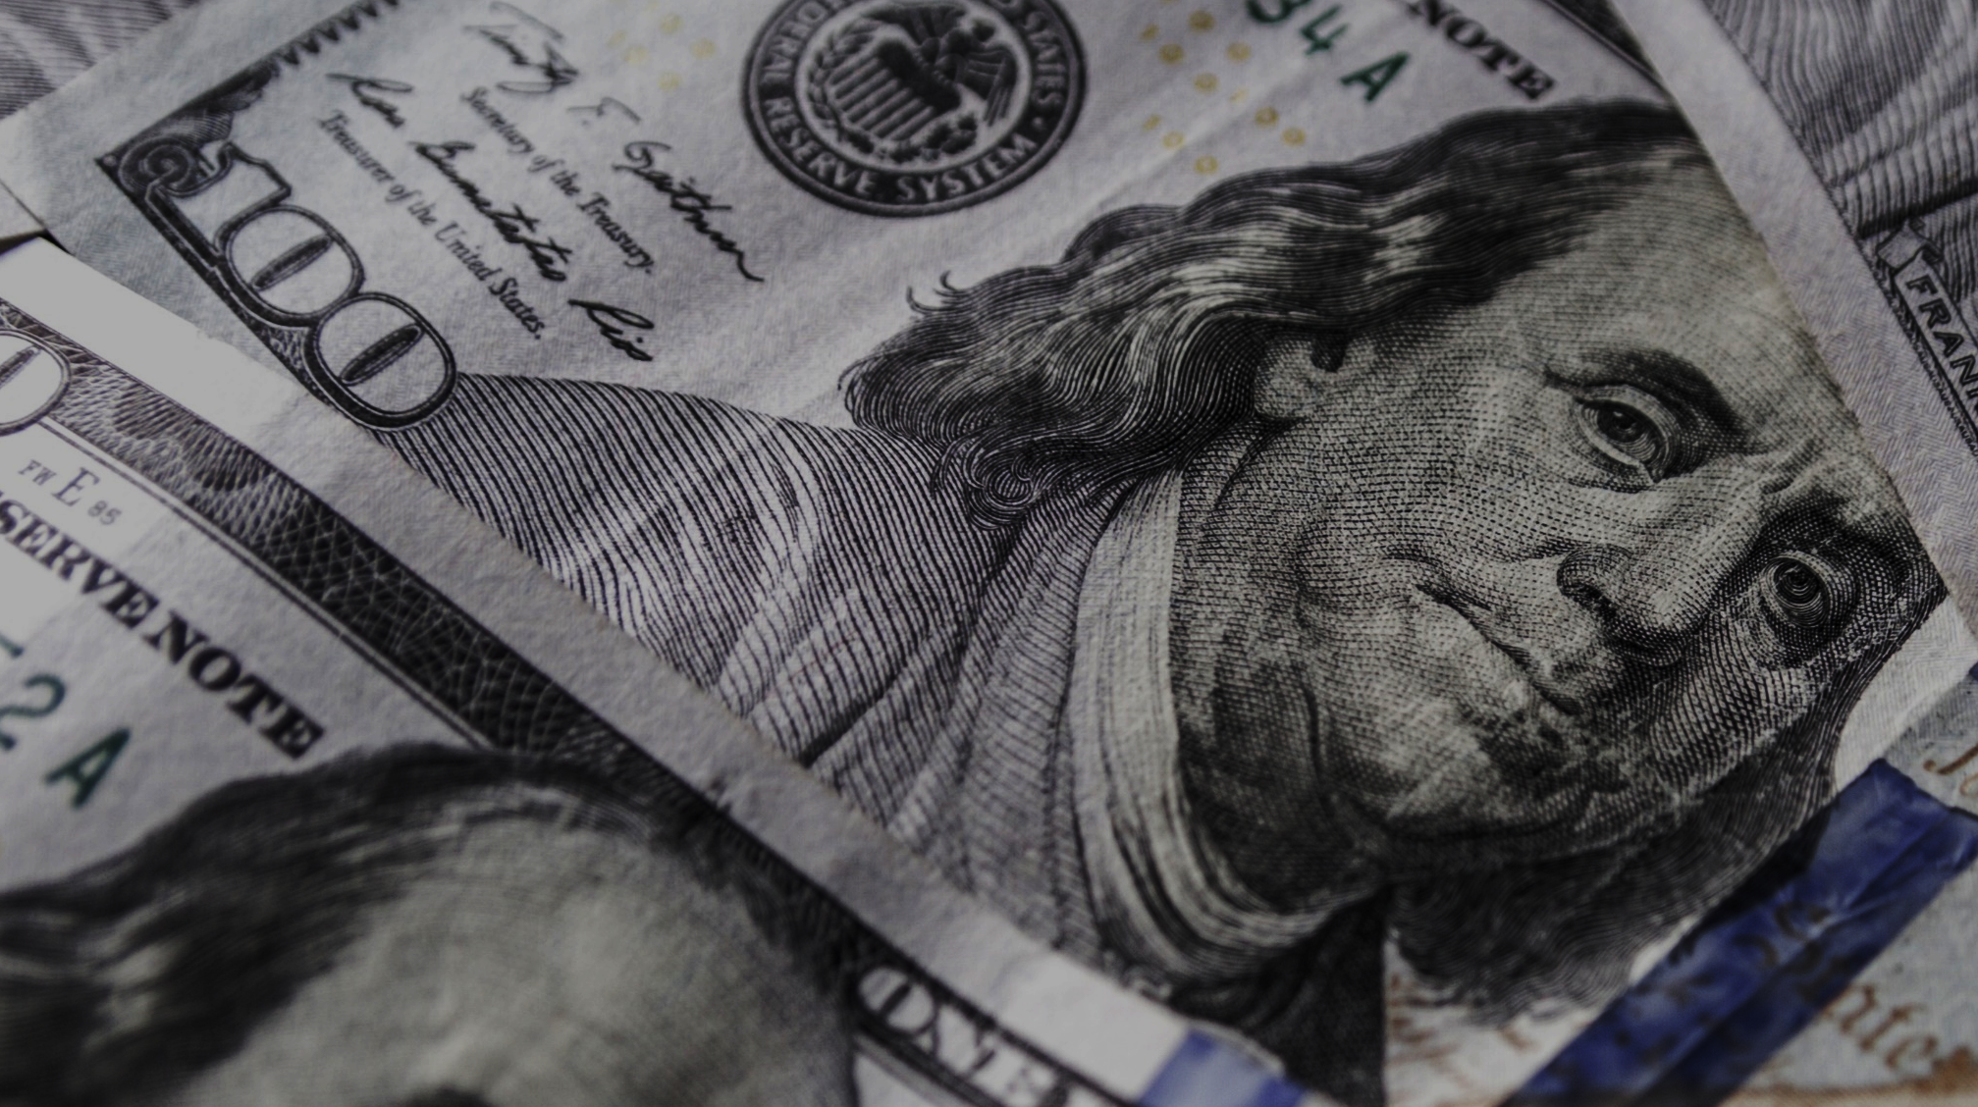
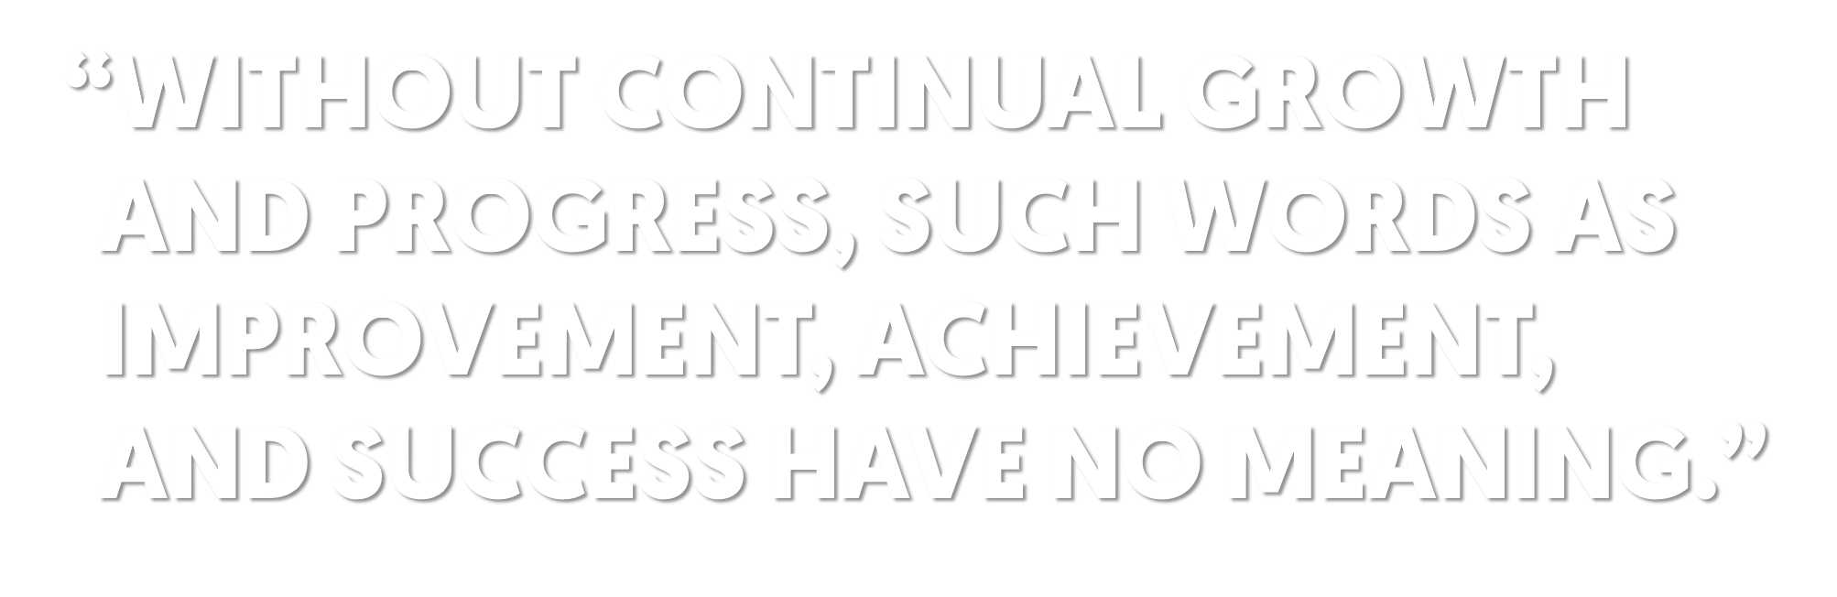

Notes:
Text: "Without continual growth and progress, such words as improvement, achievement, and success have no meaning." - Benjamin Franklin

Slide 2

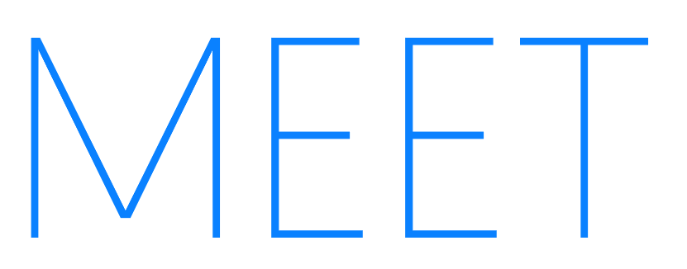


Notes:
Text: “Meet Drew Houston... He's a billionaire”

Slide 3

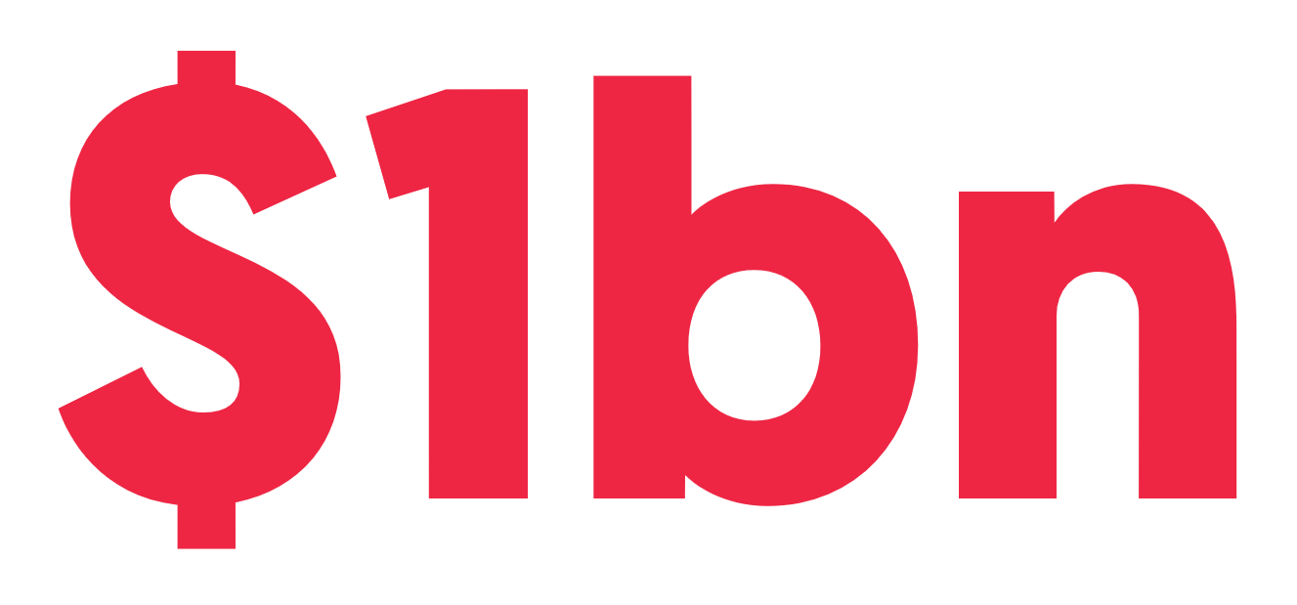

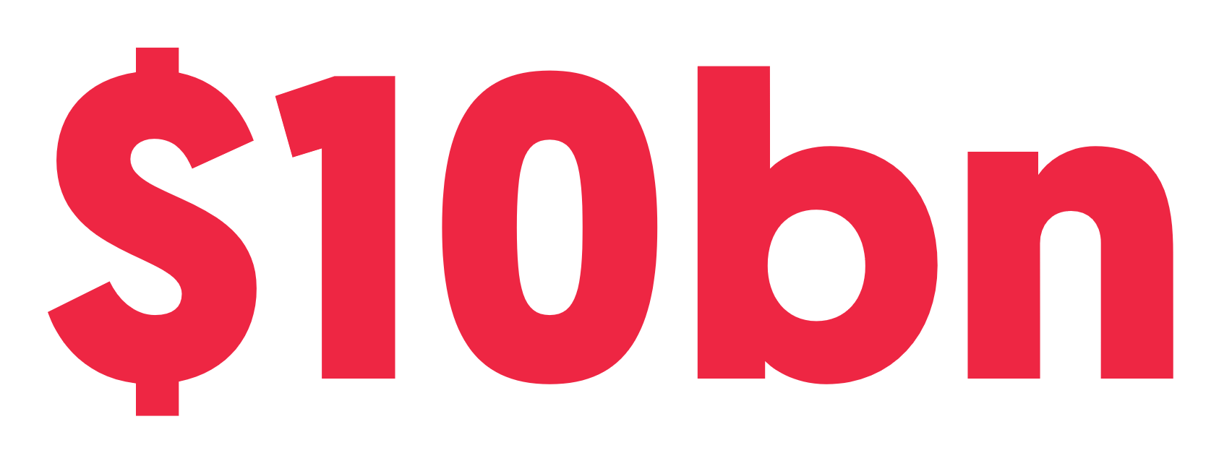

Notes:
Text: “His company has $1bn revenue and a $10bn valuation”

Slide 4


Notes:
Pic: “Dropbox logo”

Slide 5
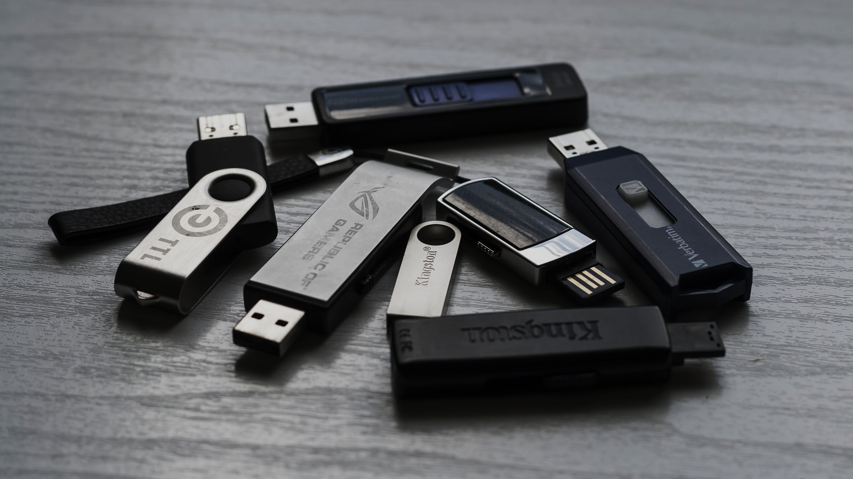

Notes:
Text: “I can fix this!”

Slide 6



Notes:
Text: “Drew knew he was solving a real problem...”
*Click 1 for text “but how was he going to let you know?”

Slide 7


Notes:
Text: “Growth Hacking”

Slide 8

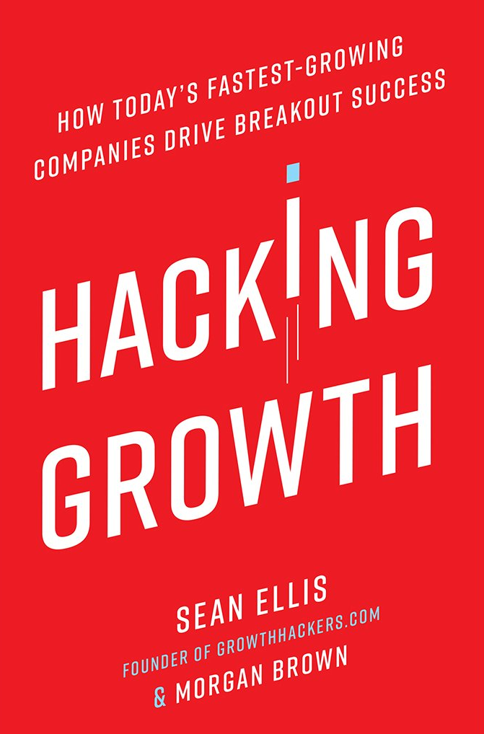
Notes:
Pic: “Sean Ellis beside his book, Hacking Growth”

Slide 9



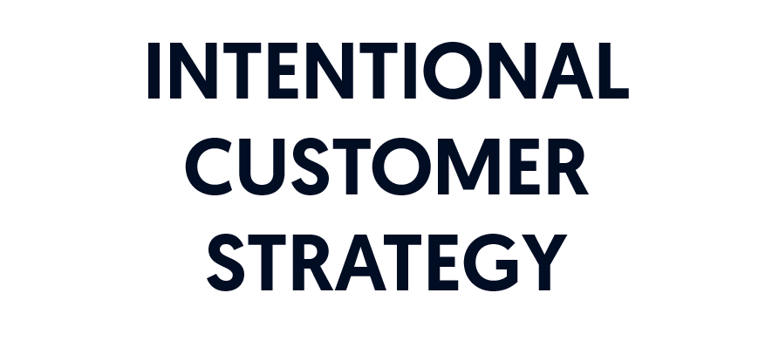

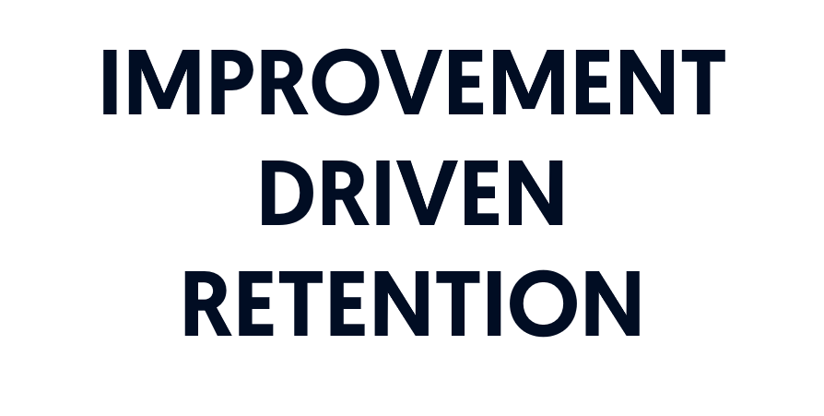
Notes:
Text: “The cornerstones of growth hacking”
*Click 1 for icon & text “Product Market Fit”
*Click 2 for icon & text “Intentional Customer Strategy”
*Click 3 for icon & text “Inherent Virality”
*Click 4 for icon & text “Improvement Driven Retention”

Slide 10
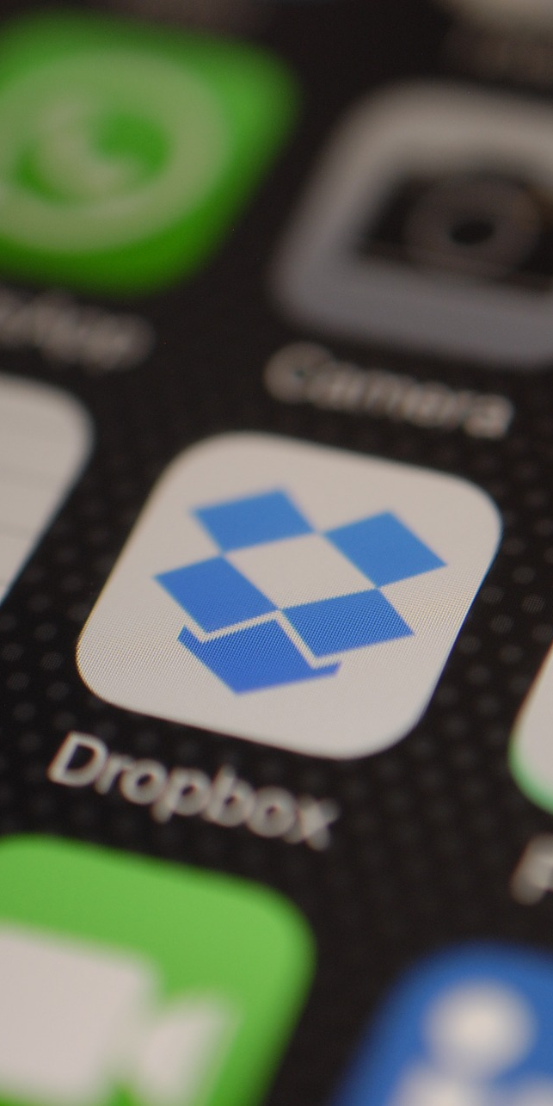




Notes:
Text: “Who in this room has never used dropbox?”
*Click 1 for text “What is that?”

Slide 11
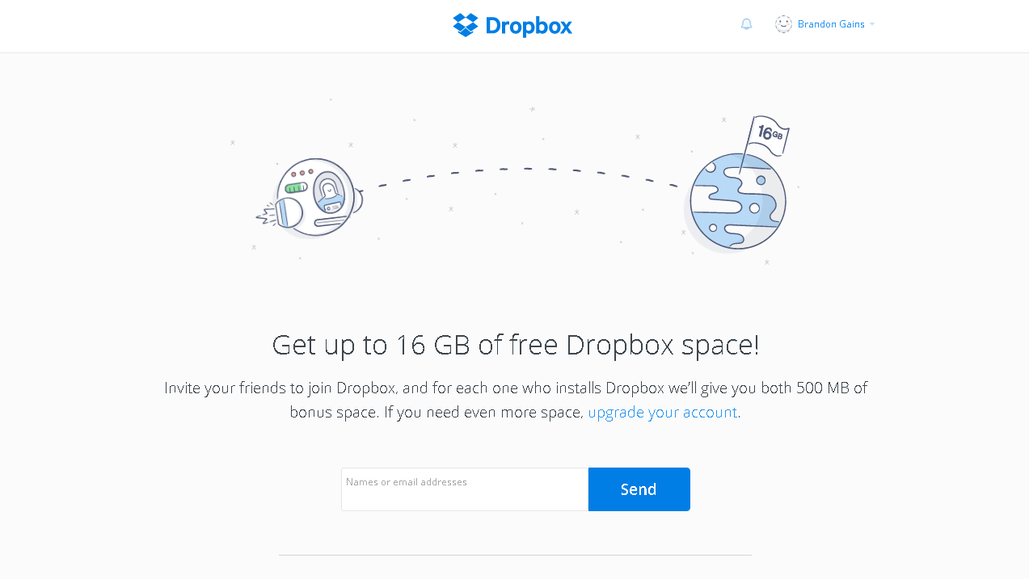
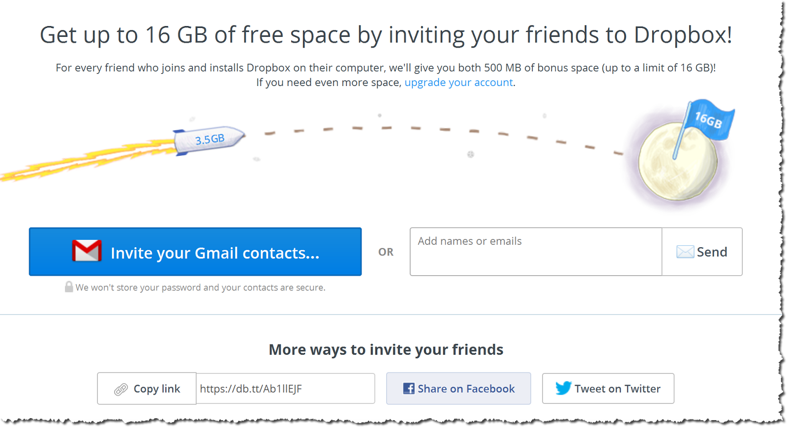
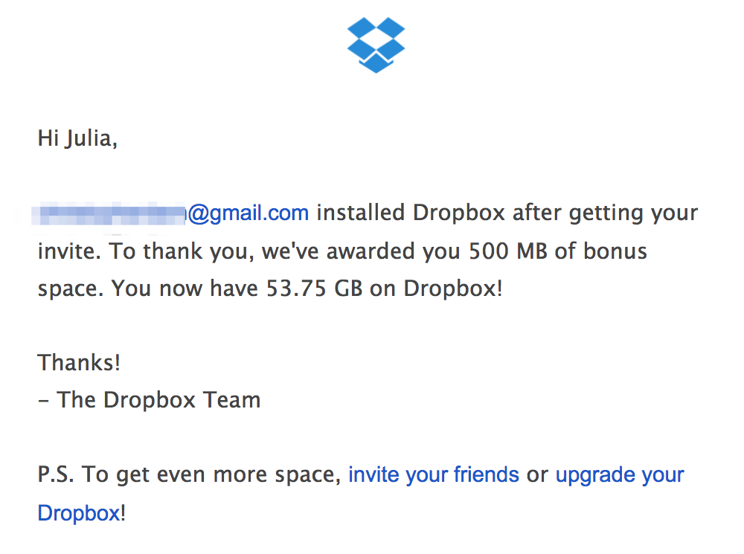
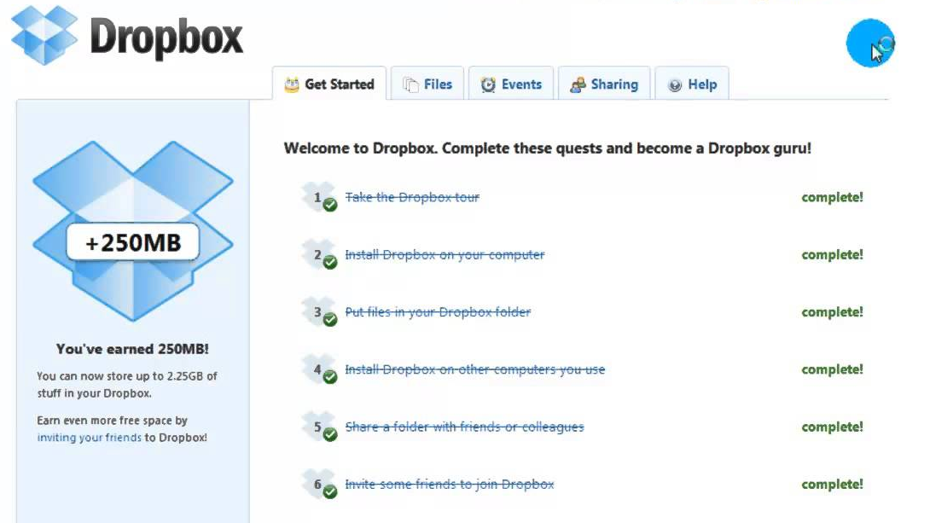
Notes:
Pic: “Get up to 16g for inviting your friends”
*Click 1 for screengrab “Even easier to invite friends”
*Click 2 for screengrab “Email update on progress”
*Click 3 for screengrab “Gamified steps to become a Dropbox Guru”

Slide 12



Notes:
Text: “This got them to 500 million users!”

Slide 13




Notes:
Text: “What could we do that would unlock this level of product virality?”
*Click 1 for text “What would we have to change to be better at this?”

Slide 14

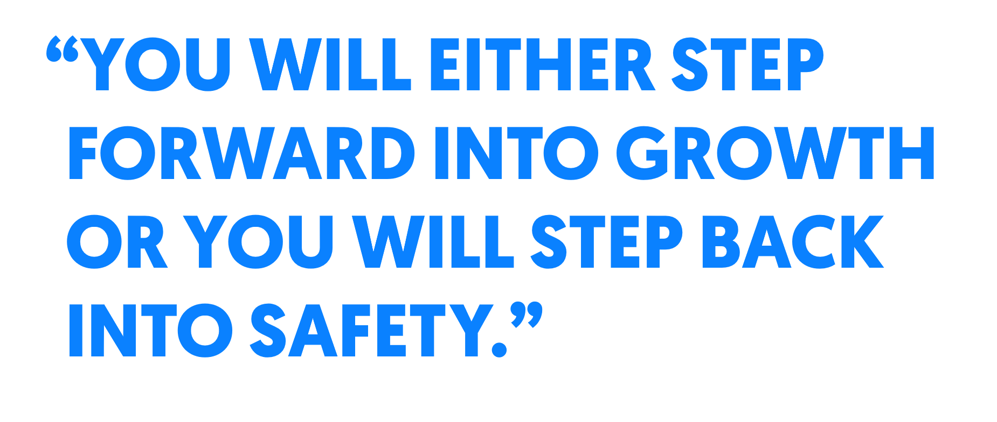

Notes:
Text: "You will either step forward into growth or you will step back into safety.” Abraham Maslow, Psychologist, Creator of Maslow's Hierarchy of Needs
*Click 1 for text “So...what's it going to be?”

